Slide 1
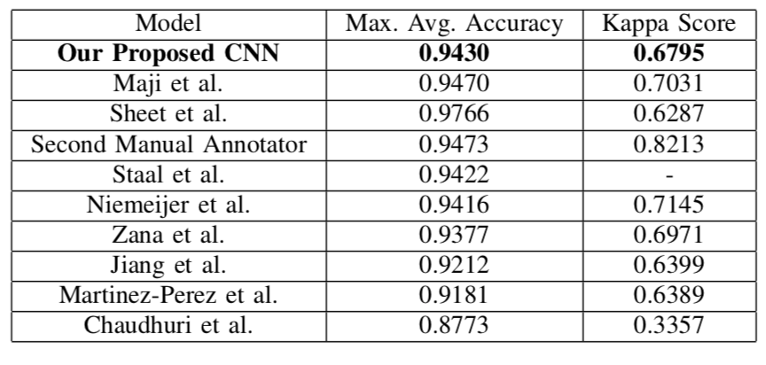
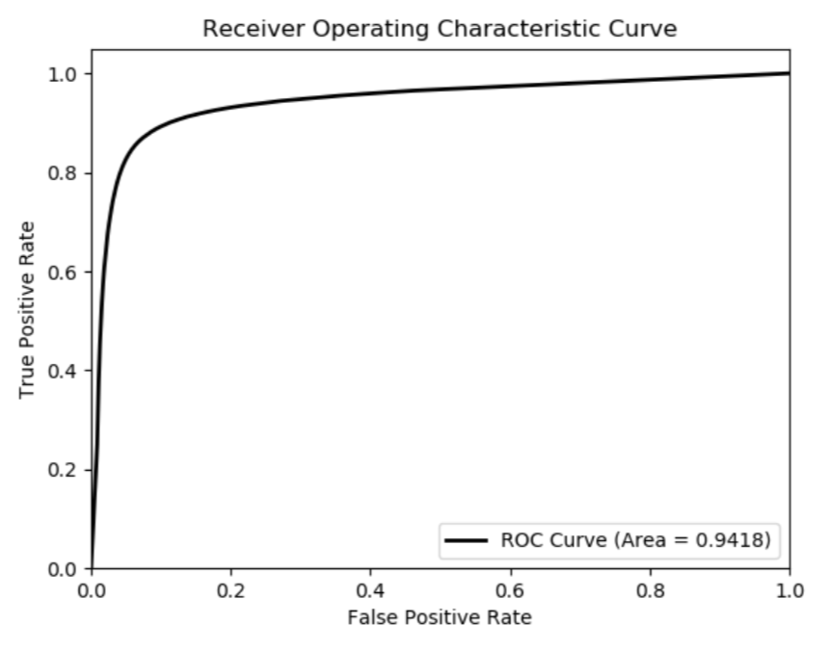
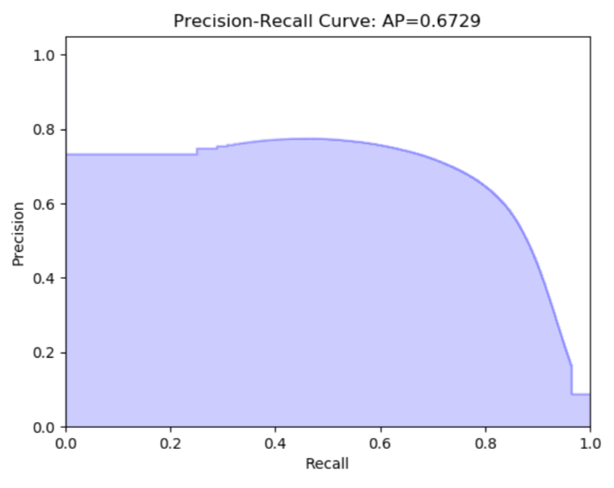
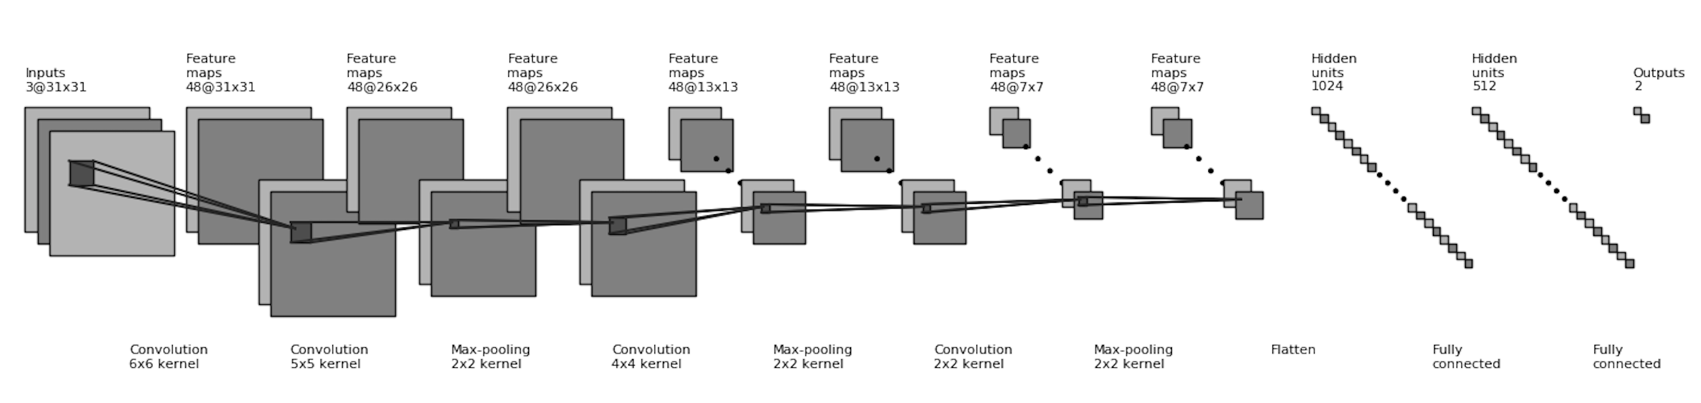
2D Retinal Vessel Segmentation using Convolutional Neural Networks
Kevin Huynh (704283105) and Zicheng Liu (004460333)
Department of Computer Science
University of California, Los Angeles
Background
In the medical domain, 2D retinal vessel imaging using fundus cameras is an integral tool in diagnosing various diseases.
To extract more relevant medical information from these types of images, it is necessary to segment them, separating the retina blood vessels from the non-vessel tissue surrounding them.
The highest-performing models of late are based upon the max-pooling convolutional neural network (CNN) [1].
A max-pooling convolutional neural network is a CNN that alternates between convolutional filtering layers and max-pooling layers before finally outputting to a fully connected layer that predicts the most probable class of the pixel [3]. Because the filters extract local features from the images, CNNs do particularly well for retinal vessel image segmentation [1].
Methods
We built a machine learning model, specifically a max-pooling convolutional neural network [3], to automatically segment 2D retinal blood vessel images.
We trained and tested our model on the publicly available dataset DRIVE: Digital Retinal Images for Vessel Extraction [4]. This dataset consists of 20 training and testing retinal images along with manual blood vessel segmentations completed by a human expert.
Before training the model, we divided our images into 120,000 patches and normalized the images by subtracting the mean intensity of the pixels.
We trained 13 models of differing number of hidden units and dropout probabilities, and then ran cross-validation, choosing the version with the highest mean accuracy on the testing images as our model.
Results
We segmented the images by classifying each pixel as a part of a retina blood vessel or not. We then used metrics including the receiver operating characteristic (ROC) curve, the precision-recall curve, maximum average accuracy score, and Cohen Kappa score to measure the performance of our model.
Conclusion
Our CNN does not beat the state-of-the-art; however, it is comparable and performs very well considering its simple architecture.
Our model can be improved by appending more data to our training set by pre-processing the images more complexly, including rotating and scaling the images before obtaining the image patches.
We can further tune the hyper-parameters by changing the filter sizes and strides of the convolutional and max-pooling in our model. With an un-optimal filter size, the most discriminative features may not be extractable. Thus, fine-tuning the filter size can improve our model's performance as it plays an important role in local feature extraction.
Automatic image segmentation tools such as ours can be extremely useful as an assistant for healthcare professionals who must manually segmexwnt 2D retina blood vessel images every day.
References
M. M. Fraz et al., “Blood vessel segmentation methodologies in retinal images - A survey,” Computer Methods and Programs in Biomedicine, 2012, vol. 108, no. 1, pp. 407-433.
D. Maji, A. Santara, P. Mitra, and D. Sheet, “Ensemble of Deep Convolutional Neural Networks for Learning to Detect Retinal Vessels in Fundus Images,” arXiv:1603.04833, 2016.
J. Masci, A. Giusti, D. Ciresan, G. Fricout, and J. Schmidhuber, “A fast learning algorithm for image segmentation with max-pooling convolutional networks,” 2013, pp. 2713-2717.
J.J. Staal, M.D. Abramoff, M. Niemeijer, M.A. Viergever, B. van Ginneken, “Ridge based vessel segmentation in color images of the retina”, IEEE Transactions on Medical Imaging, 2004, vol. 23, pp. 501-509.

